Slide 1
JMCSS Instructional Framework

Slide 2
Do Now
THINK – WRITE
What teacher moves are necessary for students to be successful learners?
(Write 3-5 sentences.)
PAIR - SHARE

Slide 3
Learning Target
Essential Question:
How will full implementation of SEE & IPG instructional framework change my instructional practices and my expectations for student success?

Slide 4
“There is a lot of sitting
and listening and not a lot of thinking.”
Robert Pianta (on his observations of more than 1,000 classrooms)
From
Schmoker, M. Focus: Elevating the Essentials to Radically Improve Student Learning (2011) ASCD: Alexandria. P. 50.

Slide 5
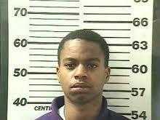
STAGGERING STATISTICS
"Two-thirds of students who cannot read proficiently by the end of 4th grade will end up in jail or on welfare."
"Over 70 percent of America's inmates cannot read above a 4th grade level."

Slide 6
STAGGERING STATISTICS
"Nearly 85 percent of the juveniles who face trial in the juvenile court system are functionally illiterate, proving that there is a close relationship between illiteracy and crime and more than 60 percent of all inmates are functionally illiterate.”

Slide 7
STAGGERING STATISTICS
"75 percent of Americans who receive food stamps perform at the lowest 2 levels of literacy, and 90 percent of high school dropouts are on welfare."
"Reports show that low literacy directly costs the healthcare industry over $70 million every year."

Slide 8
Literacy is the Spine to Learning
“Think of literacy as a spine; it holds everything together. The branches of learning connect to it, meaning that ALL teachers have a responsibility to teach literacy.”
Vicky Phillips and Carina Wong
Schmoker, M. Focus: Elevating the Essentials to Radically Improve Student Learning (2011) ASCD: Alexandria. P. 50.

Slide 9
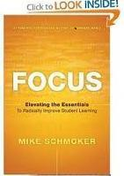
Dr. Riddile, Foundation for Moving Forward
Changed Culture – Mindsets – the invisible (Dweck)
Change learning (professional and personal) habits for teachers and students (Duhig)
Literacy is our key Focus (Schmoker) as well as the "common ground of the Common Core.“
Quality Questioning: The instructional key to THINKING is Questioning
Students should be doing the thinking and the learning! Never Work Harder Than Your Students

Slide 10
SEE Implementation
One step at a time
Keep your FOCUS

Slide 11
SEE Instructional Framework
STARTER:
Greet
Focus Activity
Objectives/ Outcomes
ENGAGEMENT:
Purpose
Gradual Release
Chunking
Questions
Tasks
ENDING:
Closure
Assess
Reflect
← RELATIONSHIPS – Personalization →
Core Action 1: Standard Alignment & High Quality Text
Core Action 2: Questions & Tasks
Core Action 3: Student Work & Mastery

Slide 12
“Having rarely read and never been taught to read textbooks, students lack the deeper reading, writing and inquiry that college requires.”
From the book, Focus by Mike Schmoker Schmoker, M. Focus: Elevating the Essentials to Radically Improve Student Learning (2011) ASCD: Alexandria. P. 35.
Reading is a “PRACTICE” skill. The ONLY way to improve reading is to READ!

Slide 13
Let’s Practice!
Read the article and answer the questions.
Small group discussion
Whole Group Discussion

Slide 14
Agenda
Starter
Engagement
Ending
Standard Alignment
Core Action 1
Core Action 2
Core Action 3

Slide 15
Section 1: The Starter
How to begin

Slide 16
The Starter: Approximately 7-12 minutes
Teacher greets students as they enter with a smile
Learning begins when students enter the room
A focusing activity (bell-ringer, do now, etc.) is posted or ready for students before they enter
“3 to 5”
3 to 5 questions answered or 3 to 5 sentences written
The focusing activity is related to a previous or the current lesson
All students are seated and begin work without direction from the teacher
The focusing activity is reviewed or discussed
Learning objectives/outcomes are posted & communicated
Based on the standard(s) being taught

Slide 17
The Entrance: Threshold
embed video of man greeting students
Greet students with a smile!
Notes:
Threshold - One pager

Slide 18
The Entrance: Positive Praise
image
description

Slide 19
The “Do Now”
Learning should begin when students enter the room.
Students enter, sit, and begin a focus activity without direction from the teacher.
This means a focusing activity (bellringer, do now, spiral review, etc.) should be posted prior to students entering the classroom.
These activities can be related to a previous lesson or the current lesson.
They should contain 3-5 questions to answer or sentences to write.
The focusing activity should be reviewed or discussed prior to the start of the lesson.
“My Favorite No” LINK
Notes:
“Without direction from the teacher” is a procedure that has been modeled and practiced with students.
My Favorite No is just one way you can review this material. Think back to our do now….we paired and shared after our writing.
Remember this all occurs within the first 7-12 minutes of class.

Slide 20
Example Do Nows
images or links

Slide 21
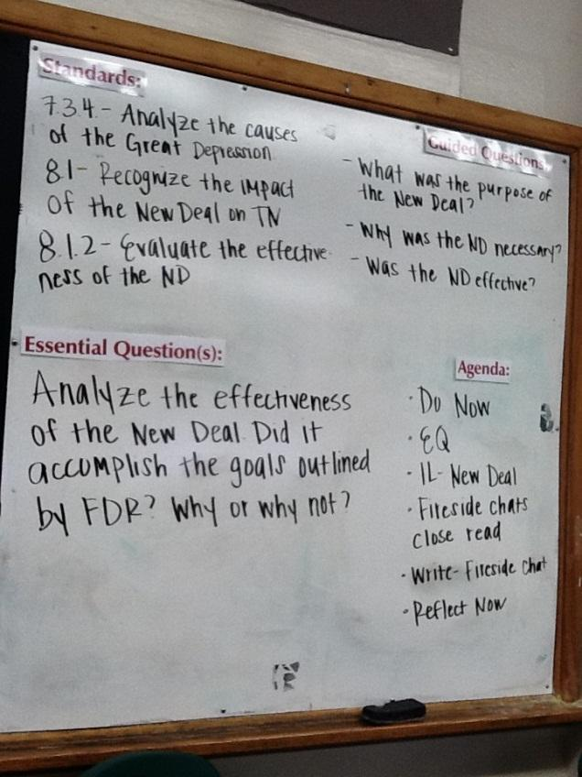
The purpose:
Learning objectives/outcomes are posted.
current lesson (not all standards for entire unit/year)
communicated (stated in student friendly terms)
explain unknown terms within the objective/outcome (ie: decompose – to break into parts)
involve students in the process (Ask and revisit to see if students can explain the desired outcome)

Slide 22
Section 2: The Engagement
How to ACTIVATE Learning

Slide 23
The Engagement:
Purposeful reading, writing, and discussion throughout the lesson
Gradual Release: I do, we do, you do
small “chunk” alone or in pairs while teacher formatively assesses/checks for understanding and re-teaches as needed, you do alone (independent practice to display mastery)
There will be multiple cycles of this process in one lesson
Chunking utilized to break lessons into small segments in order to provide frequent feedback and identify any areas that need re-teaching

Slide 24
Reading text
Discussion of text
Writing about text

Slide 25
The Engagement:
Chunking utilized to break lessons into small segments in order to provide frequent feedback and identify any areas that need re-teaching
Students are actively engaged with the teacher or other students (Avoid the void)
Teacher talk:
Cold calling, life-lines, no opt-outs
Students SLANT
Sit up, Lean Forward, Ask and Answer Questions, Note key information, and Track the speaker
Students working:
Teacher purposefully circulates and utilizes Praise, Prompt, and Leave to check for understanding and provide feedback
Can you reach every student in 8 steps?
Working in pairs is given preference over small groups due to increased engagement opportunities
Think, Write, Pair, Share

Slide 26
Purposeful reading, writing, and discussion throughout the lesson
Notes:
Anchor/supporting text is being utilized.
Connected to the standard.
Appropriate text complexity.
Students understand why they are reading, writing, and discussing. – Refer back to the starter where you revisit the objectives/outcomes.

Slide 27
The Engagement: Gradual Release
Notes:
Pay close attention to the fact that this cycle should occur multiple times within one class period.

Slide 28
modeling examples/video

Slide 29
The Engagement: Chunking
Rule of 10 and 2 (Chunk and Chew)
STRATEGIES HERE

Slide 30
The Engagement: Feedback
Hattie’s research here
Feedback
Austin’s butterfly VIDEO
questions to think about

Slide 31
The Engagement: Avoid the Void
TEACHER:
Cold Call (method for calling)
Lifelines
No Opt Out
Stretch It
SLANT
ADD VIDEOS
image
Notes:
One pagers

Slide 32
The Engagement: Avoid the Void
STUDENTS WORKING:
Circulate
Praise, Prompt, Leave (A&A)
8 steps
Pairs
ADD STRATEGIES & VIDEOS
image
Notes:
One pagers

Slide 33
Section 3: The Ending
How to close

Slide 34
The Ending: Approximately 7-12 minutes
Has a system of time keeping
Closure
Restate
Reflect
Teacher uses formative assessments to:
Inform instruction: What do I teach tomorrow?
Target review
Focus remediation
“3 to 5”: 3 to 5 questions answered, or 3 to 5 sentences written
Remind

Slide 35
Standard Alignment & High-Quality Text
Instructional Practices Guide: Core Action 1

Slide 36
Standard Alignment
The lesson reflects the demand of the standard.

Slide 37
Core Action 1A
A majority of time is spent reading, writing, or speaking about text(s)*.
For classrooms outside of ELA, data representations, diagrams, or other representations of information may be appropriate. In that situation, the rest of the questions using the word “text” would then rely on the source of information described above. However, use of text is still expected a majority of the time.
Brief informational videos may be appropriate depending on the standard(s) being taught.
Notes:
Discuss bullet one with group – what does that look like in each subject area
Bullet 2: emphasize brief and standard

Slide 38
DISCUSSION
Deep, meaningful discussions about text
“If we want students to become clear, articulate speakers, teachers must demonstrate, model, and reinforce expectations throughout student discussions.” (p.85)
Schmoker, M. Focus: Elevating the Essentials to Radically Improve Student Learning (2011) ASCD: Alexandria. P. 85.

Slide 39
Core Action 1 Text Examples

Slide 40
Core Action 1B
The text(s) are at or above the quantitative and qualitative complexity level expected for the grade and time in the school year and exhibit exceptional craft or build knowledge.
The texts can be entered and re-entered for different purposes.
Examples: Books, poems, short stories, articles, selections from a textbook, etc. used to teach the standard(s)

Slide 41
add how to determine text complexity slides add examples of enter/re-enter the text

Slide 42
Questions & Tasks
Instructional Practices Guide: Core Action 2

Slide 43
Core Action 2A
Most questions and writing tasks return students to the text to build understanding of the text and the standard(s) being taught.
Students can be seen reading or being read to, followed by discussing and/or responding to questions or tasks (orally or written), and re-entering the text to clarify or extend their understanding of what they have read.

Slide 44
Praise, Prompt, Leave (Assess/Advance), 8 Steps/Room Arrangement
Gradual Release, Chunking
Text dependent questions

Slide 45
Core Action 2B
Most questions and writing tasks require students to collect and use evidence from the text to demonstrate understanding and to support their ideas about the text.
Questions should be answered through a student’s understanding that is then able to be supported by text evidence. Most questions should not be able to be answered only by the text evidence.
During any silent reading time or interactive lecture, students have a purpose for reading or listening and are noting evidence, thoughts, etc. in some way.

Slide 46
Core Action 2B
Cold Call, Lifelines, No Opt Out, Stretch It
What are students doing?/Accountable talk

Slide 47
Core Action 2C
Most questions and writing tasks focus students on the most important words, phrases, and sentences that matter most to understanding the text and how they are used in the text.
Students are asked to address vocabulary, phrases, and sentences in context of what they are reading and not in isolation.
Unless a cold read is specifically called for or needed, teachers preview the words, phrases, and sentences that are essential to students’ comprehension of the text.

Slide 48
how to vocab

Slide 49
Core Action 2D
Most questions are intentionally sequenced to support building knowledge by guiding students to delve deeper into the text.
Questions show a progression from basic to complex (increasing the level of demand of the questions).
The sequence of questions guides students’ thinking to the main takeaways desired by the teacher’s task (as determined by the standard ).

Slide 50
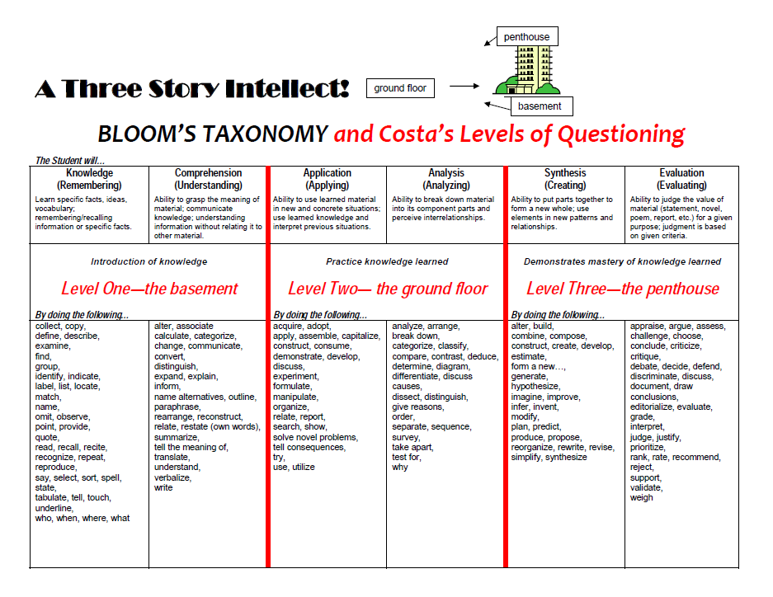

Slide 51
Questioning tips (ie: pre-plan, think to ?)

Slide 52
Student Work & Mastery
Instructional Practices Guide: Core Action 3

Slide 53
Core Action 3A
The teacher provides opportunities for productive struggle and perseverance with tasks that meet the standards.
Wait time is provided.
Tasks are chunked into smallest units possible in order to provide maximum opportunities for feedback.
During whole group instruction, the teacher utilizes cold calling, life-lines, and no pot-outs to ensure all students have multiple opportunities to engage.
When students are working alone or with a partner, the teacher utilizes “Praise, Prompt, Leave” to provide feedback.
The teacher utilizes information gained from questioning and circulating among a majority of the students to determine if re-teaching is necessary within each chunk.
Notes:
Remind teachers of 10/2 strategy from slide 17
Remind Cold call, lifelines, no opt out slide 19
Praise, prompt, leave, 8 steps slide 20

Slide 54
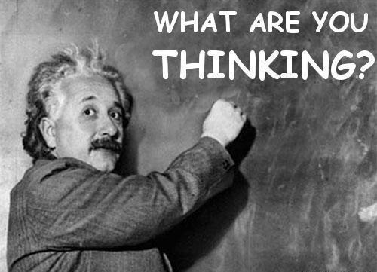
THINKING
“Students acquire knowledge and thinking skills best when they learn reciprocally, when they are asked to read, write, argue, and problem solve as they engage with text and with an organized body of essential knowledge.”
“We learn and retain information best when we have a chance to evaluate or think about it.”
Schmoker, M. Focus: Elevating the Essentials to Radically Improve Student Learning (2011) ASCD: Alexandria. P. 32.
Do NOT think for your students!!

Slide 55
Perseverance/struggle

Slide 56
Core Action 3B
The teacher expects evidence and precision from students and probes students’ answers accordingly. Students display persistence in providing textual evidence to answers and responses, orally and/or in writing.
The teacher does not accept “general” statements as evidence, but pushes for clear and specific evidence that adequately backs up a student’s response.
During whole group instruction, the teacher cold calls on students and pushes them for the best evidence possible
When students are working alone or with a partner, the teacher utilizes “Praise, Prompt, and Leave” to push students who need re-direction or whose responses need to be more specific
The teacher utilizes information gained from questioning and circulating among a majority of the students to determine if re-teaching is necessary within each chunk

Slide 57
Add examples
How to push for clear specific – stretch it
Text evidence

Slide 58
Mastery
Teaching to mastery of all students is targeted throughout the lesson

